Slide 1
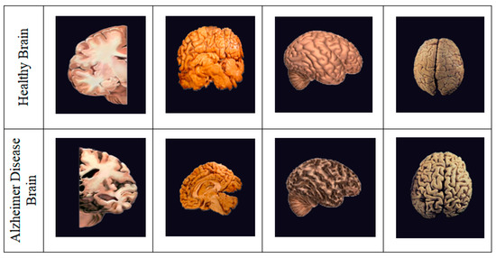
Alzheimer’s Disease Classification Using Machine Learning
A Data-Driven Approach for Early Detection
Group Members:
Pornima Shrikant Shelke
Ananya Indudhara
Dinesh Padhan
Avranil Dutta
Adhul Paramel Sathish
Venkata Nagaraju Jagu
Subburu Manoj Kumar
Mentor – RP Adhvaith
Co-Mentor – Sunkarapelli Mounika
Notes:
Good morning, everyone. Our project is titled Alzheimer’s Disease Classification using Machine Learning. The focus of this work is to apply a structured machine learning pipeline on healthcare data and evaluate multiple models objectively to identify the most suitable classifier.

Slide 2
Problem Statement
Challenges in Applying Machine Learning to Alzheimer’s Data
Alzheimer’s datasets contain heterogeneous features such as demographic, clinical, and cognitive data
Manual analysis of such high-dimensional data is inefficient and difficult to scale
Identifying meaningful patterns for disease stage classification is a complex task
There is a need for automated machine learning models to accurately classify disease stages
Machine learning enables efficient pattern recognition and classification from complex Alzheimer’s datasets.
Notes:
From a machine learning perspective, Alzheimer’s datasets are complex and high-dimensional. They include demographic, medical, and cognitive features. Manual analysis becomes inefficient as data grows, and identifying meaningful patterns for diagnosis is challenging. This motivates the need for automated, data-driven classification models.

Slide 3
Project Objective
Primary Objective
To design and implement a machine learning–based classification system for predicting Alzheimer’s disease stages, with a focus on tree-based ensemble models.
Secondary Objectives
To preprocess and analyze structured and categorical patient data
To train and compare 12 classification model
To evaluate model performance using standard classification metrics
To identify the most effective model for disease stage prediction
CatBoost demonstrated strong performance due to its efficient handling of categorical features.
Notes:
The primary objective of this project was to design a supervised machine learning classification system. Secondary objectives included preprocessing structured and categorical data, training multiple models, evaluating them fairly using standard metrics, and selecting the most effective model.

Slide 4
Dataset Overview
Dataset Description
The dataset contains records of 2,149 patients aged 60–90 years
Each record represents a patient with demographic, lifestyle, medical, clinical, and cognitive attributes
The dataset is designed for supervised machine learning classification
Feature Categories
Demographic Details: Age, Gender, Ethnicity, Education Level
Lifestyle Factors: BMI, Smoking, Alcohol Consumption, Physical Activity, Diet & Sleep Quality
Medical History: Family History, Diabetes, Cardiovascular Disease, Hypertension, Depression
Clinical Measurements: Blood Pressure and Cholesterol Levels
Cognitive & Functional Assessments: MMSE, ADL, Functional Assessment
Symptoms: Confusion, Forgetfulness, Disorientation, Behavioral Changes
Target Variable: Diagnosis
Binary classification: 0 → No Alzheimer’s Disease
  1 → Alzheimer’s Disease
The dataset contains a high number of categorical and structured features, making it well-suited for tree-based models such as CatBoost.
Notes:
The dataset consists of 2,149 patient records with ages ranging from 60 to 90 years. It includes demographic, lifestyle, medical, clinical, and cognitive features. The target variable is a binary diagnosis, which makes this a supervised classification problem.
Mention Features categories

Slide 5
Data Preprocessing
Purpose of Data Preprocessing
To transform raw patient data into a machine-learning-ready format
To ensure data consistency, quality, and reliability
To improve model training and generalization performance
Preprocessing Steps Performed
Handling Missing Values:
Missing or inconsistent values were identified and handled to maintain data integrity
Encoding Categorical Variables:
Categorical features such as Gender, Ethnicity, and Education Level were encoded for model compatibility
Feature Scaling:
Numerical features were scaled where required to maintain uniform value ranges
Feature Selection & Cleaning:
Irrelevant and confidential fields (e.g., DoctorInCharge) were removed from the dataset
Preprocessing is performed independently of any specific model to ensure a fair comparison across multiple algorithms.
Notes:
Before training models, preprocessing was performed to ensure data quality and consistency. This involved handling missing values, encoding categorical variables, scaling numerical features where required, and removing irrelevant or confidential fields. Importantly, preprocessing was done independently of any specific model to ensure fair comparison.
This is a high-scoring slide—don’t rush.

Slide 6
Exploratory Data Analysis (EDA)
Why Exploratory Data Analysis is Important
To understand the distribution and characteristics of the dataset
To identify patterns, correlations, and anomalies in features
To derive insights that inform preprocessing and model selection
The following slides present key EDA findings using selected visualizations.
Notes:
Exploratory Data Analysis helped us understand feature distributions, detect anomalies, and study relationships between variables. The next slides present selected EDA findings that influenced preprocessing and modeling decisions.

Slide 7
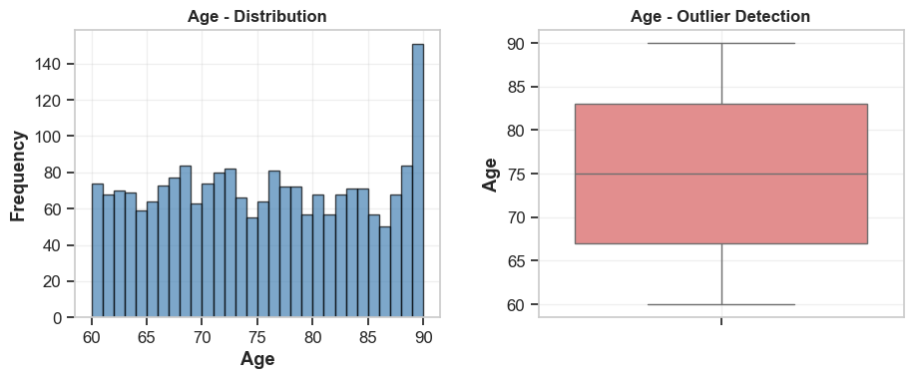
Numerical Feature Analysis – Age (Representative Example)
Key Observations
Age values are well distributed within the expected range
No extreme outliers that require removal
Age is shown as a representative numerical feature. Similar distribution and outlier analyses were performed for all numerical variables during EDA.
Notes:
Age is shown as a representative numerical feature. The histogram shows a well-distributed range within expected limits, and the boxplot indicates no extreme outliers. Similar distribution and outlier checks were performed for all numerical features.

Slide 8
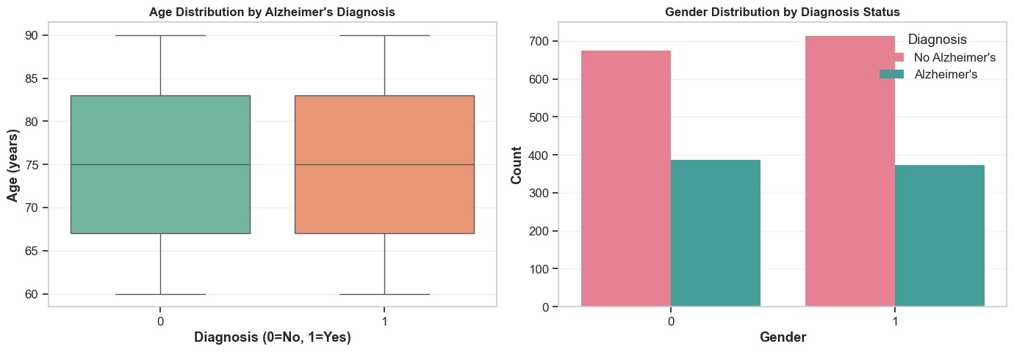
BIVARIATE ANALYSIS - Feature vs Diagnosis Relationships
Key Observations
Alzheimer’s tend to be slightly older on average
Gender distribution is relatively balanced across diagnosis classes
This suggests age may carry stronger predictive signal than gender alone
Bivariate analysis helps assess how individual features vary across target classes and supports feature relevance evaluation for machine learning models.
Notes:
This slide presents bivariate analysis, where we examine how individual features relate to the target variable. From the age distribution, we observe that patients diagnosed with Alzheimer’s tend to be slightly older. In contrast, the gender distribution appears relatively balanced across both diagnosis classes, suggesting that gender alone may have limited predictive influence. These observations help us understand feature relevance before model training.

Slide 9
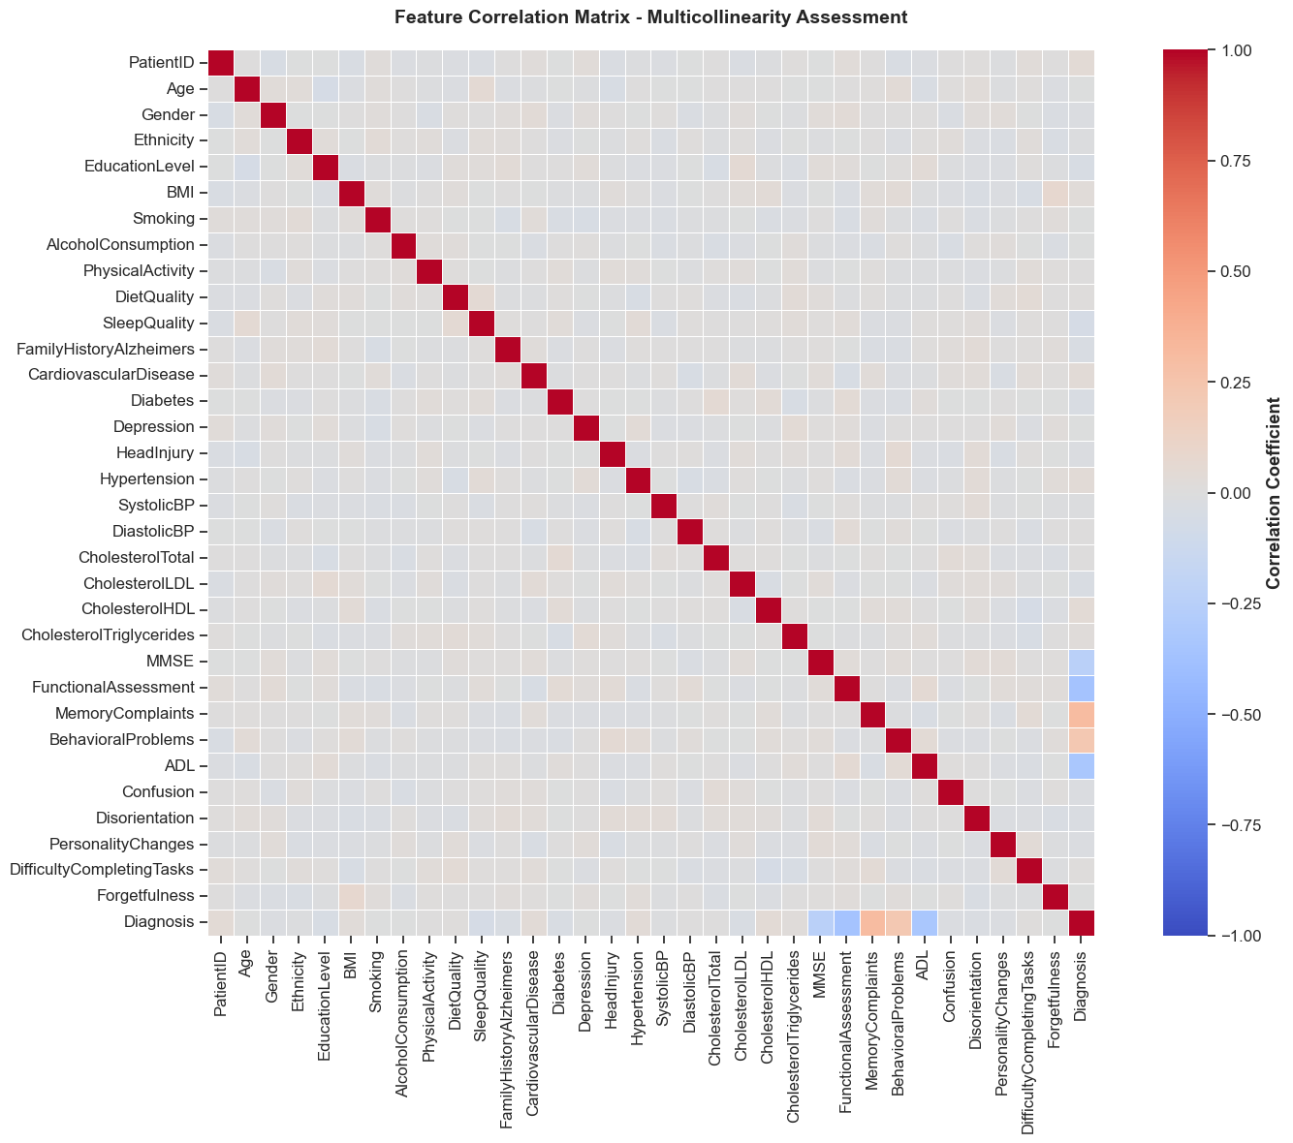
BIVARIATE ANALYSIS - Feature vs Diagnosis Relationships
Key Observations
Most features show low to moderate correlation with each other
No strong multicollinearity is observed among input variables
Cognitive and functional features show stronger correlation with the diagnosis variable
This reduces the risk of model instability and redundancy
Correlation analysis helps identify redundant features and ensures stable model training by minimizing multicollinearity.
Notes:
This correlation matrix helps identify relationships among features and detect multicollinearity. Most features show low to moderate correlation, indicating minimal redundancy. This supports stable and reliable model training without aggressive feature elimination.

Slide 10
Model Building Overview
Section 1: Machine Learning Approach
Section 2: Modeling Strategy
Machine Learning Approach
The problem is formulated as a supervised classification task
Input features include demographic, lifestyle, clinical, and cognitive variables
The target variable is Alzheimer’s diagnosis (binary classification)
Modeling Strategy
Multiple classification algorithms were trained and evaluated under a common framework
All models were trained using the same preprocessed dataset
Performance comparison was done using standard evaluation metrics
Section 3: Training & Evaluation Setup
Training & Evaluation
Dataset split into training and testing sets
Models trained on the training set
Final evaluation performed on unseen test data
A consistent training and evaluation framework ensures fair comparison across all machine learning models.
Notes:
After completing exploratory data analysis, we moved into the model building phase. The problem was formulated as a supervised binary classification task, with Alzheimer’s diagnosis as the target variable. We used demographic, lifestyle, clinical, and cognitive features as inputs. Multiple classification algorithms were trained using the same preprocessed dataset and the same train–test split. This consistent training and evaluation setup ensures a fair comparison across all models before identifying the best-performing one.

Slide 11
Machine Learning Models Implemented
Section 1: Baseline Models
Section 2: Tree-Based Models
Baseline Models
Logistic Regression
Naïve Bayes
k-Nearest Neighbors (KNN)
Tree-Based Models
Decision Tree
Random Forest
Section 3: Ensemble & Boosting Models
Section 4: Margin-Based & Other Models
Ensemble & Boosting Models
Gradient Boosting
XGBoost
LightGBM
CatBoost
Other Classification Models
Support Vector Machine(SVM)
AdaBoost
Using a diverse set of models enables robust performance comparison and reduces algorithmic bias.
Notes:
To ensure a fair and comprehensive evaluation, we implemented a diverse set of machine learning models. These include baseline classifiers, tree-based models, ensemble methods, and boosting algorithms. Each model was trained using the same dataset and evaluation framework, allowing us to objectively compare their performance before selecting the best-performing approach.

Slide 12
Model Evaluation Metrics
Section 1: Why Evaluation Metrics Matter
Section 2: Metrics Used
Why Evaluation Metrics Are Important
Accuracy alone may be misleading in imbalanced datasets
Multiple metrics provide a balanced performance assessment
Evaluation Metrics Used
Accuracy – Overall correctness of predictions
Precision – Proportion of correctly predicted positive cases
Recall – Ability to identify actual Alzheimer’s cases
F1-Score – Balance between precision and recall
Section 3: Evaluation Strategy
Evaluation Strategy
Metrics computed on the test dataset
Same metrics applied to all models
Ensures fair comparison across algorithms
Using multiple evaluation metrics ensures reliable and unbiased assessment of classification models.
Notes:
To evaluate model performance, we used multiple classification metrics instead of relying only on accuracy. Since the dataset shows moderate class imbalance, precision, recall, and F1-score provide a more reliable assessment. All models were evaluated on the same test dataset using these metrics to ensure fair comparison.

Slide 13
Model Performance Comparison
Section 1: Comparison Overview
Section 2: Performance Summary (Main Content)
Overview
All models were evaluated using the same test dataset
Performance was compared across Accuracy, Precision, Recall, and F1-score
This ensures objective and unbiased comparison
Model Performance Summary
Model | Accuracy | Precision | Recall | F1-Score | AUC
Logistic Regression | 0.7860 | 0.7381 | 0.6118 | 0.6691 | 0.8370
SVM | 0.7767 | 0.7857 | 0.5066 | 0.6160 | 0.8259
Decision Tree | 0.7372 | 0.6226 | 0.6513 | 0.6367 | 0.7177
Random Forest | 0.8326 | 0.9255 | 0.5724 | 0.7073 | 0.8786
Gradient Boosting | 0.8326 | 0.8846 | 0.6053 | 0.7188 | 0.8824
XGBoost | 0.8209 | 0.8378 | 0.6118 | 0.7072 | 0.8536
LightGBM | 0.8116 | 0.7983 | 0.6250 | 0.7011 | 0.8576
KNN | 0.7093 | 0.6080 | 0.5000 | 0.5487 | 0.7396
GNB | 0.8047 | 0.7881 | 0.6118 | 0.6889 | 0.8498
MLP | 0.7256 | 0.6214 | 0.5724 | 0.5959 | 0.7440
AdaBoost | 0.8140 | 0.8051 | 0.6250 | 0.7037 | 0.8758
CatBoost | 0.8372 | 0.8942 | 0.6118 | 0.7266 | 0.8786
Section 3: Key Observations
Key Observations
Ensemble and boosting models generally show stronger performance
Baseline models provide useful reference benchmarks
Performance varies across metrics, reinforcing the need for multi-metric evaluation
Notes:
This slide presents a comparative summary of model performance across multiple evaluation metrics. All models were evaluated on the same test dataset to ensure fairness. We observe that while baseline models provide useful benchmarks, ensemble and boosting methods generally achieve stronger and more consistent performance. Since performance varies across metrics, we avoid relying on a single metric for final model selection.

Slide 14
Best Model Selection
Section 1: Selection Criteria
Section 2: Selected Model
Model Selection Criteria
Consistent performance across Accuracy, Precision, Recall, and F1-score
Strong generalization on unseen test data
Robust handling of feature types and data distribution
Selected Model: CatBoost Classifier
Reasons for Selection:
Achieved strong and consistent performance across evaluation metrics
Effectively handles categorical and numerical features
Demonstrated better generalization and stability compared to other models
Section 3: Practical Considerations
Practical Considerations
Reduced need for extensive feature encoding
Lower risk of overfitting due to built-in regularization
Suitable for real-world tabular datasets
The final model was selected based on balanced performance and generalization rather than a single evaluation metric.
Notes:
Based on the comparative evaluation across multiple metrics, CatBoost was selected as the final model. The selection was not based on accuracy alone, but on consistent performance, generalization ability, and robustness to different feature types. CatBoost demonstrated stable behavior on unseen test data, making it suitable for this classification task

Slide 15
CONCLUSION & KEY TAKEAWAYS
Section 1: Project Summary
Section 2: Key Takeaways
Successfully framed Alzheimer’s diagnosis as a supervised machine learning classification problem
Performed end-to-end ML workflow, including EDA, preprocessing, modeling, and evaluation
Compared multiple machine learning models using fair and consistent evaluation metrics
Exploratory Data Analysis provided critical insights into feature behavior and relationships
Using multiple evaluation metrics ensured balanced and unbiased model assessment
Ensemble and boosting methods demonstrated strong performance on structured tabular data
Section 3: Final Outcome
CatBoost emerged as the most suitable model based on overall performance and generalization
The final model demonstrates the practical applicability of machine learning to real-world datasets
This project highlights the importance of data understanding, fair evaluation, and informed model selection in machine learning workflows.
Notes:
In conclusion, this project demonstrates a complete machine learning pipeline, from data understanding to model evaluation. Through exploratory data analysis and fair comparison of multiple models, we identified CatBoost as the most suitable classifier. Overall, the project highlights how proper data preparation and evaluation strategies are crucial for building reliable machine learning solutions.

